Slide 1

SCHOOL OF ENGINEERING AND TECHNOLOGY
PRESENTATION ON
RESTAURANT BILLING SYSTEM
NAME – DISHA MOHANTY
REGD . NO – 250301370203
SUBJECT – PROGRAMMING IN C
PROGRAM/BRANCH – BTEC CSE “AIML”
ACADAMIC YEAR – 2025-2026
SEMISTAR – 1ST

Slide 2
INDEX
INTRODUCTION TO RESTAURANT BILLING SYSTEM
PROBLEM STATEMENT
OBJECTIVE OF THE PROJECT
FEATURES OF THE SYSTEM
SOME PICTURES OF THE PROJECT
CONCLUSION

Slide 3
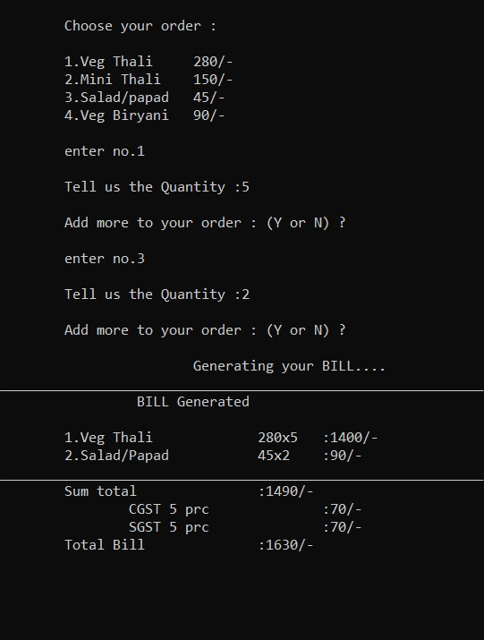
INTRODUCTION TO RESTAURANT BILLING SYSTEM
The Restaurant Billing System is a software-based solution designed to simplify and computerize the billing and menu management process in restaurants. Instead of writing bills manually and maintaining handwritten records, this system automatically calculates total bill amount, applies discount and GST, and updates stock after every order.

Slide 4
PROBLEM STATEMENT
Most restaurants still use manual billing, which takes more time and often leads to calculation mistakes in total, discount, and GST. Updating the menu, tracking stock, and storing record files is difficult without a computerized system. Because of this, restaurants need a fast and error-free billing system with secure menu management and data storage.

Slide 5
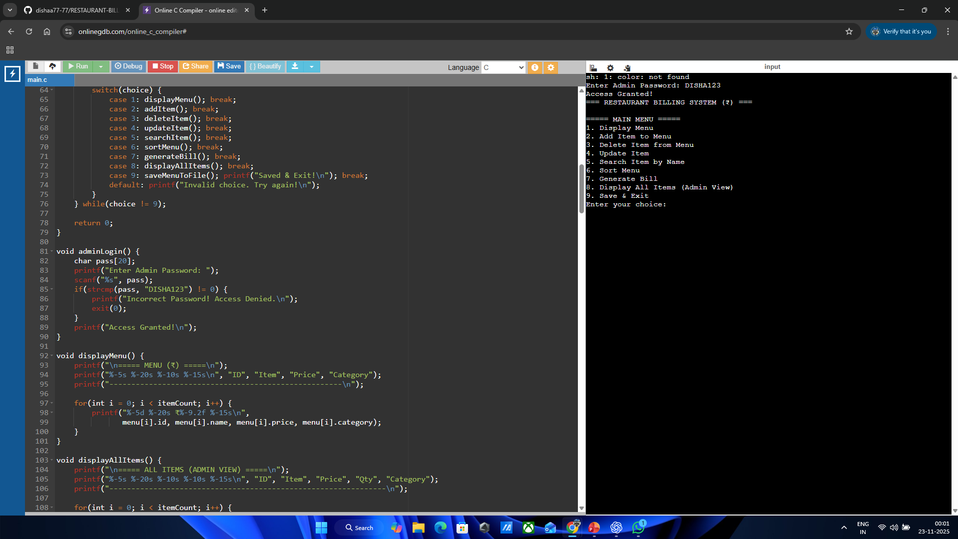
OBJECTIVE OF THIS PROJECT
To automate food billing and reduce manual errors.
To manage menu items (add, update, delete, search).
To calculate discount and GST automatically.
To update stock after every order with low stock alert.
To store menu and sales permanently using file handling.
To provide secure access using admin login

Slide 6
FEATURES OF THE SYSTEM
📌 Key Features
🔐 Admin Login – Protects menu from unauthorized changes.
➕ Add, Update & Delete Menu Items
🔍 Search items by name
↕ Sort menu (by name or price)
🧾 Generates Bill with GST & Discount
💾 Stores menu & sales permanently using files

Slide 7
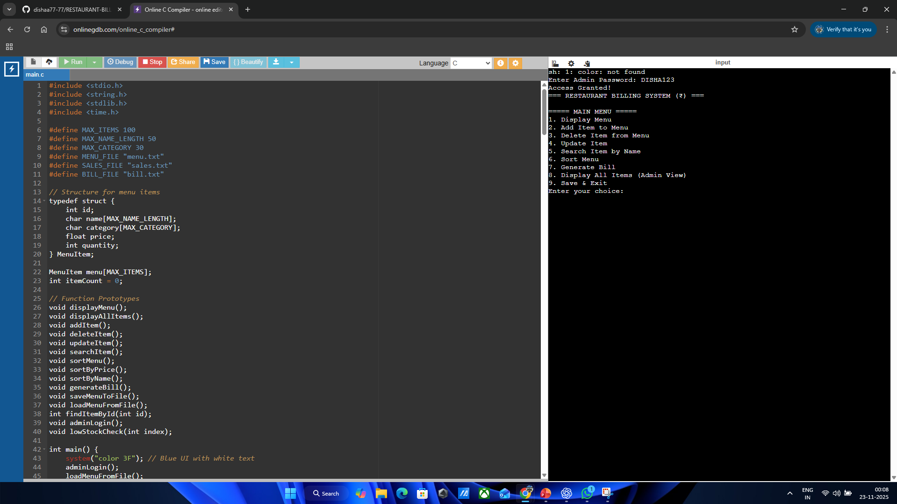
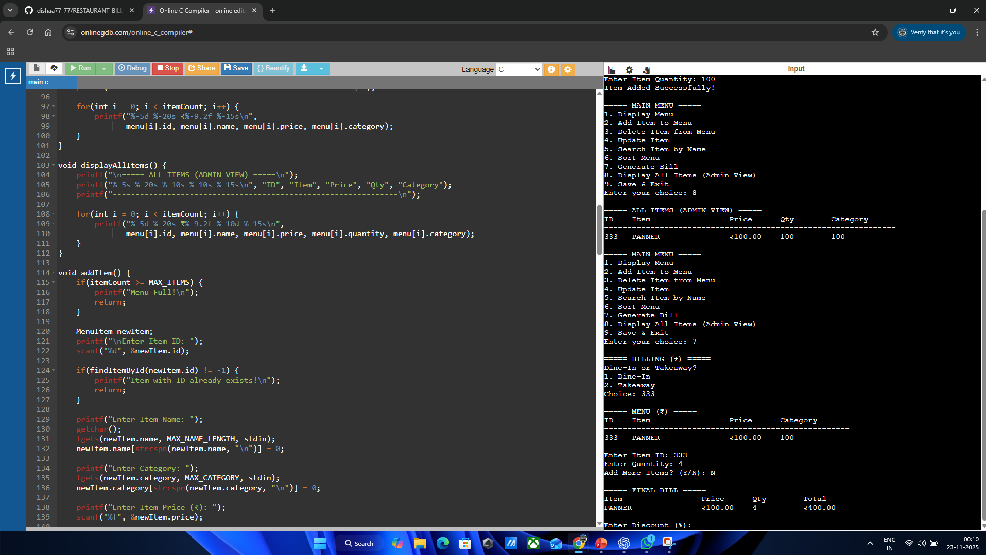
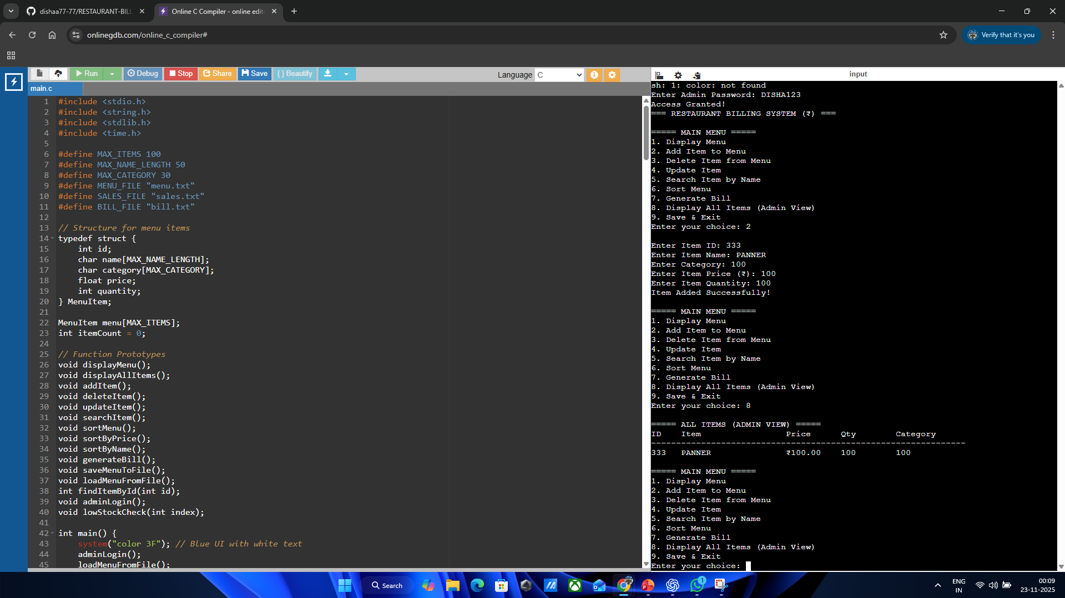
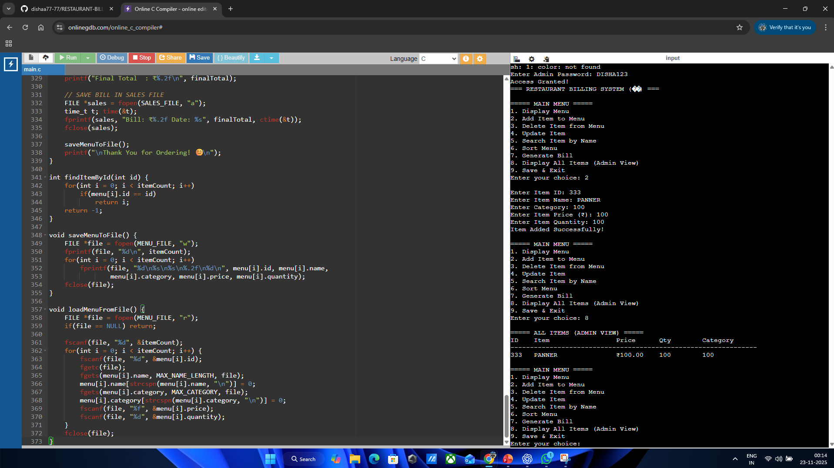
SOME PICTURES OF THE PROJECT

Slide 8
CONCLUSION
The Restaurant Billing System successfully automates the billing and menu management process. It reduces manual work, eliminates calculation errors, updates stock automatically, and securely stores data using file handling. With features like admin login, GST & discount billing, and low stock alerts, the system provides fast, accurate, and reliable service for restaurants

Slide 9


